Slide 1
Fuzzy Matching v2.0, NPN Identification, Initial Classification Results & Graph IE
January 20, 2020 Update

Slide 2
Fuzzy Matching v2.0

Slide 3
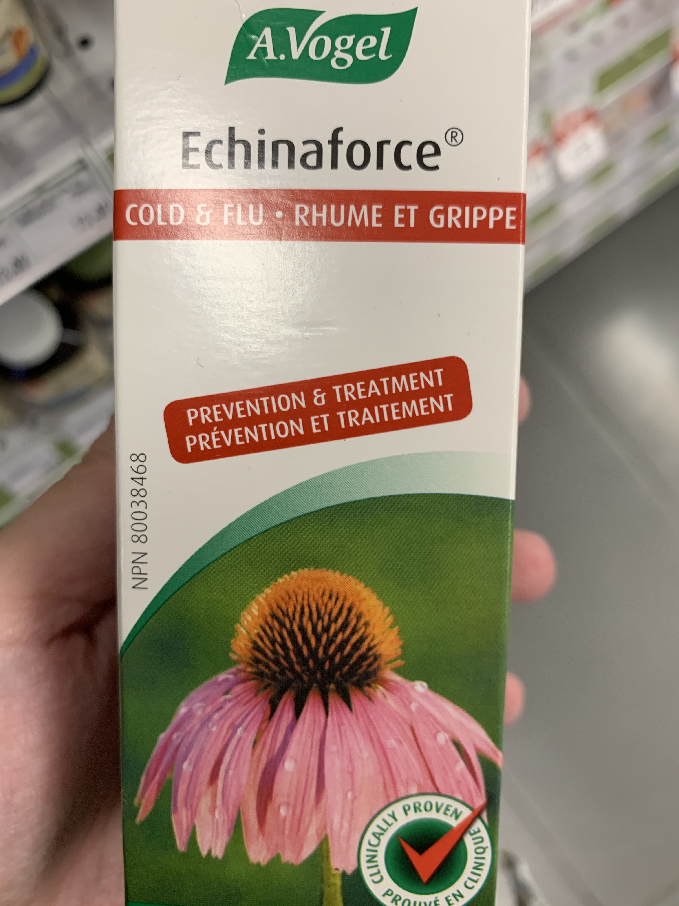
Fuzzy Matching v2.0
Previous work on FM was successful
Can successfully map OCR with spelling mistakes/punctuation to correct word in master vocabulary
Con:
FM is incredibly slow
Prohibitive for real-time use
Solution:
SymSpell Python Package
Runtime for A. Vogel product (8 images) with ~1000 ocr words
Fuzzywuzzy | symspellpy
421.3 seconds (>7min) | 0.88 seconds

Slide 4
Fuzzy Matching v2.0 – How it works
Pre-compute spelling errors on a provided vocabulary with a max_num_errors (parameter)
“ingredients” → {‘ingredient’, ‘ingredient’, ‘ingredienta’, ‘ingredientb’, ‘ingredientc’, …}
When an error is made by ocr, “ingred1ent$” → symspell returns a list of the top matching original words in your vocabulary

Slide 5
NPN Identification

Slide 6
NPN Extraction Stats
Purpose: To compare the NPN extracted from the annotated images to the NPN extracted from the OCR
Annotated Dataset: 875 products
642 labelled NPN
580 contain a digit
571 (88.9%) have a useable partial NPN, i.e. 3-8 digit NPN that can be used to query the LNHPD database

Slide 7
Comparing the NPN extract with OCR
Comparing the same 642 images with the OCR extract
501 (78%.0) match exactly with the annotated image extract
510 (79.4%) partially match (first 3 digits) with the annotated image extract
npn_annot | filename | all_text | npn_text | npn_ocr | correct | correct2
80037353 | Wobenzym ps_1.jpg | npn 80037353 polarated baldbya wobenzym resooe os colala noten a factor in ankle joint injury recuperation relieves pain associated… | npn 80037353 | 80037353 | 1 | 1
80037553 | Wobenzym ps_2.jpg | medor, npn 80037553 mores hobenzym ds ne to afactor … | npn 80037553 | 80037553 | 1 | 1
80066200 | Zuccarin Diet_1.jpg | natural health prodact produit de santa natural laturally sourced npn 80066200 | npn 80066200 | 80066200 | 1 | 1
80005483 | Wn pharma multivitamin daily_1.jpg | 6 25273! multivitamines czleo un par jour a lot [7455 maintient une bonne sante 80005483… | 80005483 npn | 80005483 | 1 | 1
80054 | Zytec Germ Buster_1.jpg | e zytec not germ busterâ€™ alcohol some free hand sanitizer foam with 80054/83 is alourizers ancel and npn kills harmful bacteria or germs 550 ml 1186 flozj | 80054/83 npn | 8005483 | 0 | 1

Slide 8
Initial Classification Results

Slide 9
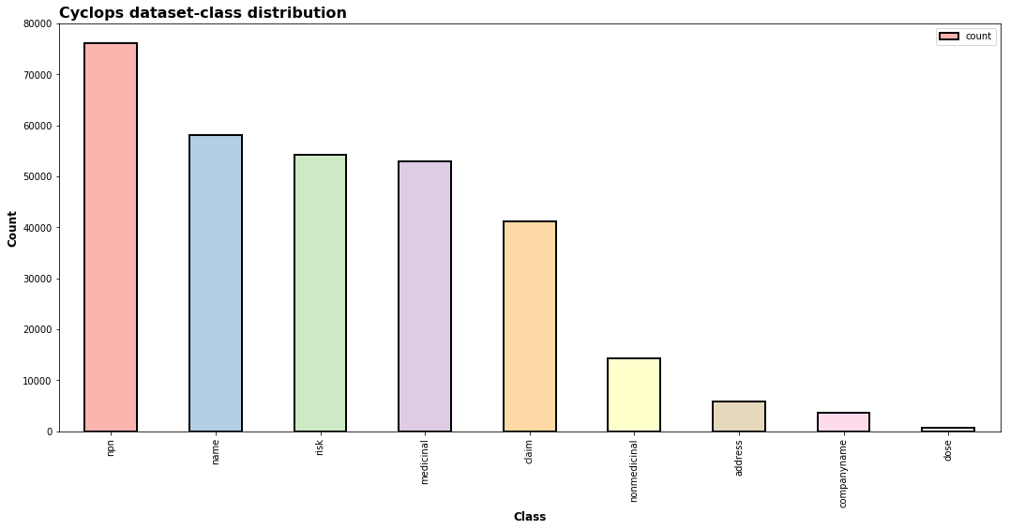
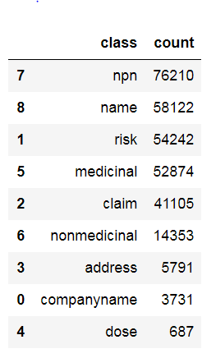
Cyclops: Class - Data Distribution

Slide 10
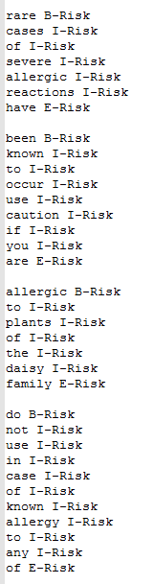
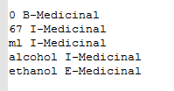
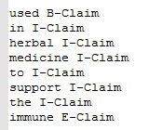
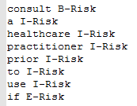

Use Cases tested using newly trained Model

Slide 11
Use Cases tested using newly trained Model (Good)

Slide 12
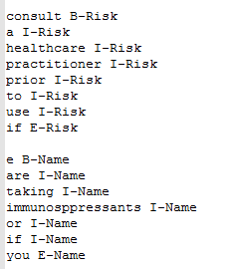
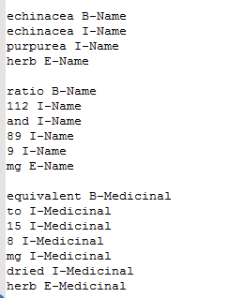
Use Cases tested using newly trained Model (Bad)

Slide 13
Graph IE Strikes Again!

Slide 14
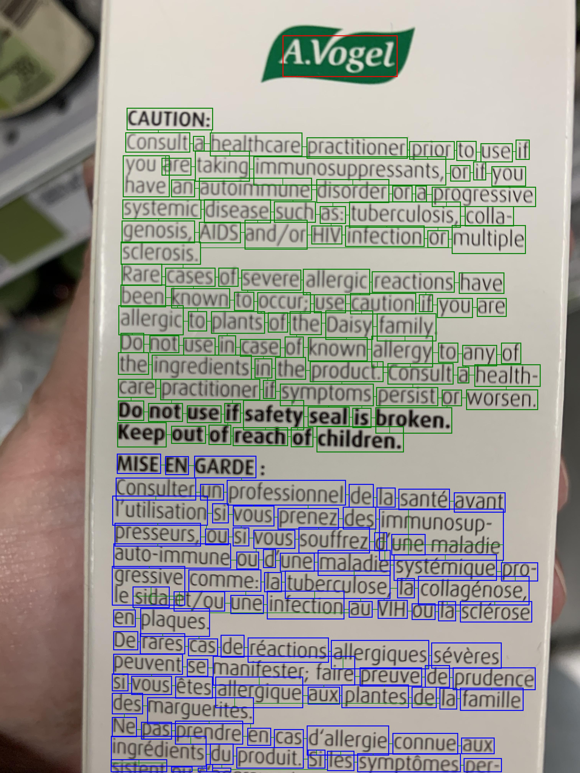
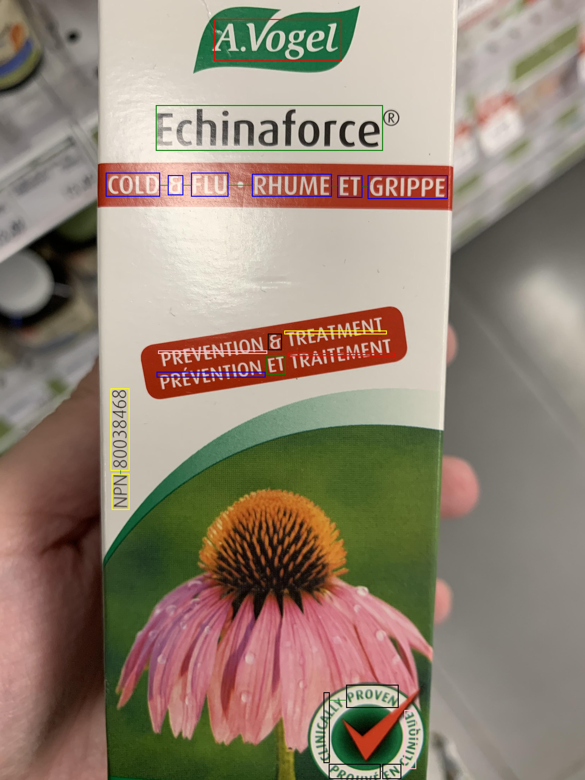
GraphIE

Slide 15
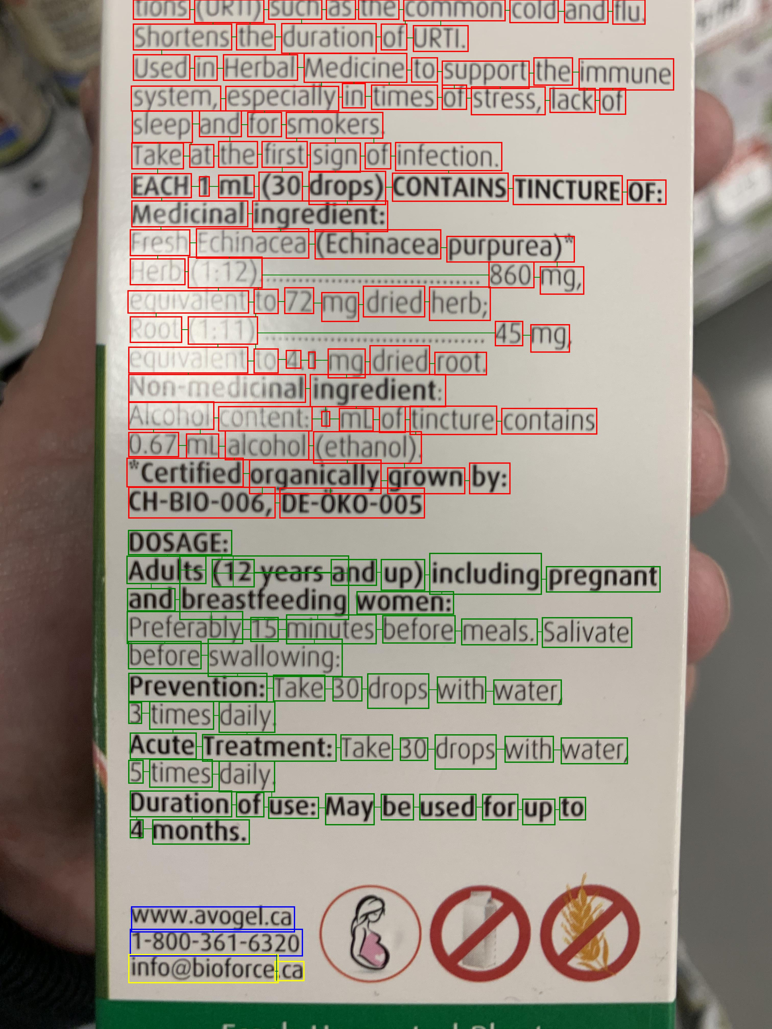
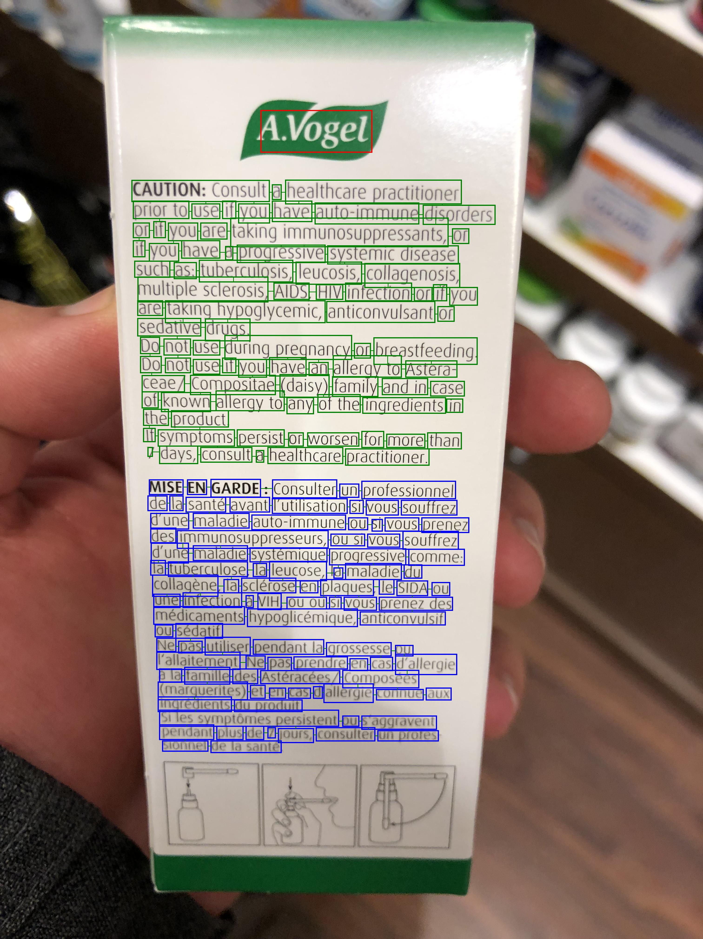
GraphIE

Slide 16
Thank You /
Je vous remercie

